Slide 1
Programming the Arduino
Arduino Program called a “Sketch”
Arduinos use the C++ language
(plus a few custom functions)

Slide 2
Flow Chart for All Arduino Programs
void setup()
Commands that happen once.
Initializations
void loop()
Commands that repeat forever
Gets the work done
Start
Start here. (Power On, Upload or Reset)
void Setup() {
Initialize stuff
}
Happens once at start-up
void Loop() {
Do stuff
}
Repeats 16 MILLION Times each Second
Flow Chart for All Arduino Sketches

Slide 3
Introducing…. The BLINK Sketch
Makes an LED blink on and off
What goes in the Setup() function?
What goes in the Loop() function?
Let’s find out

Slide 4
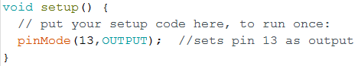
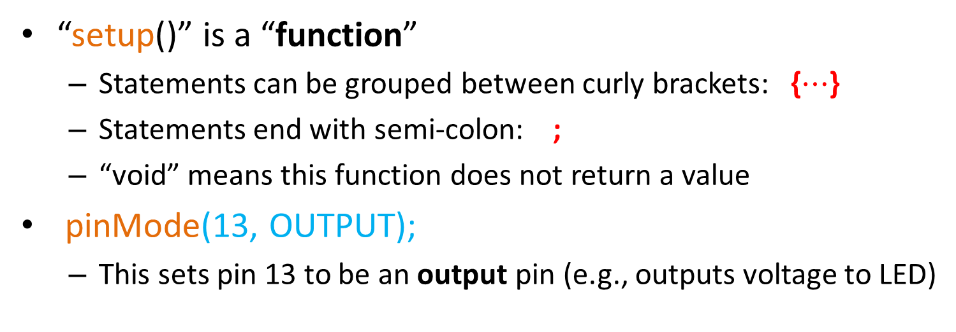
void setup() Initialize Stuff
Matching curly brackets
“setup()” is a “function”
Statements can be grouped between curly brackets: {$⋯$}
Statements end with semi-colon: ;
“void” means this function does not return a value
pinMode(13, OUTPUT);
This sets pin 13 to be an output pin (e.g., outputs voltage to LED)

Slide 5
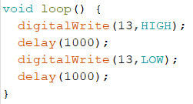
void loop() Does Stuff
Matching curly brackets
digitalWrite(13,HIGH); //sets Pin 13 to +5V (turns on LED)
delay(1000); //waits 1000 ms, which is 1 sec
digitalWrite(13,LOW); //sets 13 to 0V (turns LED off)
delay(1000); //waits another second
HIGH
…
Pin 13
LOW
0
1000
2000
3000
4000
Time (milliseconds)

Slide 6
Meaning of: HIGH and LOW
LOW means 0 volts
HIGH means the maximum system voltage
For Arduino, HIGH = +5V (= 3.3V for Raspberry Pi)
The following are all equivalent:
HIGH same as true same as 1
LOW same as false same as 0

Slide 7
Hands On
Objectives
Write the Blink sketch
Upload and experiment

Slide 8
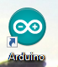
Start Desktop Arduino
Hands On
Arduino Desktop users:
Start the IDE by double clicking the Arduino desktop icon

Slide 9
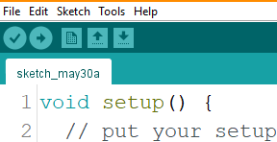
Open a New Sketch
Hands On
Click Here

Slide 10
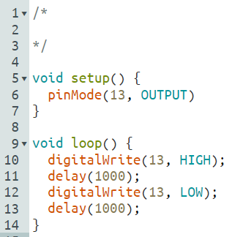
Edit Sketch to look like this:
Hands On
;

Slide 11
As you type: Be Careful! C++ is “Case Sensitive”
Hands On
E.g., you must type: pinMode
These won’t work: pinmode, PINMODE, etc
E.g., you must type: OUTPUT
It won’t work if you type: output

Slide 12
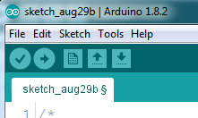
Compile, Upload, and Run
Hands On
Click Here

Slide 13
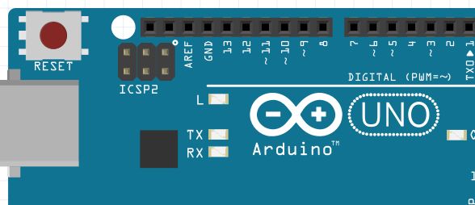
Circuit for BLINK
Hands On
For this simple experiment, we’ll use the LED that comes pre-wired on every Arduino
LED plus current limiting resistor is connected to pin 13
The LED turns on when we write HIGH to pin 13
The LED turns off when we write LOW to pin 13
Built in LED
Notes:
From https://www.arduino.cc/en/Tutorial/Foundations/DigitalPins:
NOTE: Digital pin 13 is harder to use as a digital input than the other digital pins because it has an LED and resistor attached to it that's soldered to the board on most boards. If you enable its internal 20k pull-up resistor, it will hang at around 1.7V instead of the expected 5V because the onboard LED and series resistor pull the voltage level down, meaning it always returns LOW. If you must use pin 13 as a digital input, set its pinMode() to INPUT and use an external pull down resistor.

Slide 14
Things To Try
Hands On
Experiment with different on and off delays
Click Upload after each change
E.g., what is smallest delay that can be seen?
Consider the TV frame rate (“refresh rate”)
Traditional TV uses 60 frames/sec (60 on + 60 off each sec)
Time per frame = 1/60 = .0167 sec ≈ 17 milliseconds (ms)
Try this: set blink rate = TV frame rate
Try “on” time = 8 ms; “off” time = 9 ms (total = 17 ms)
What rate causes visible flicker?
Many modern TVs use 120 frames/sec – Try it!

Slide 15
Variables
Very important in programming languages!

Slide 16
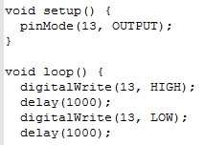
Annoying Problem
If we want to change any number (such as 13)
We must change EVERY occurrence.
Tedious and error-prone

Slide 17
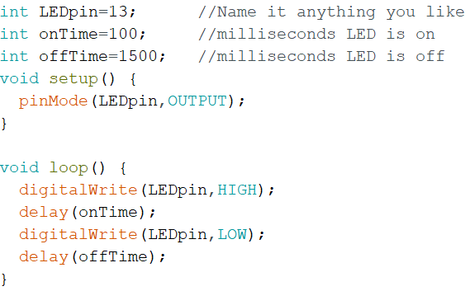
Solution: use “variables”
Modify your Blink sketch to look like this:
Optional comments
“int” declares a variable to be an integer
variables must be declared once and only once
Integer Variable “LEDpin” has been assigned value of 13
Integer Variable “onTime” has been assigned value of 100
Try changing onTime and offTime and re-run it

Slide 18



Project: Cylon (Battlestar Galactica)
Parts: 4 LEDs, 4 resistors, jumpers, Arduino
Your Challenge:
Build a Cylon circuit
Modify the Blink Code to blink 4 LEDs

Slide 19
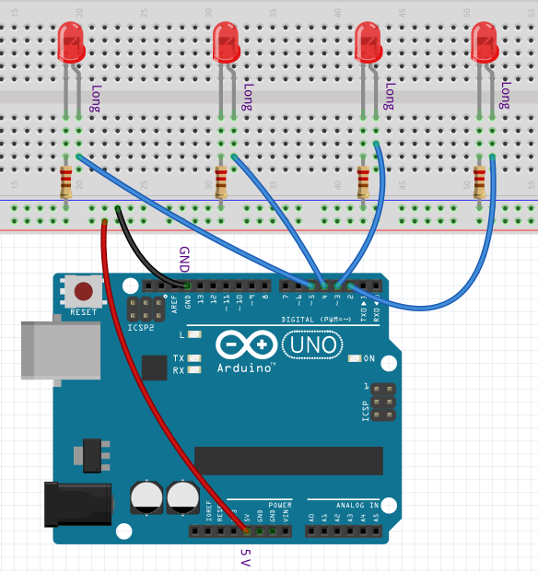
Cylon Circuit
Pins 0 and 1 are rarely used

Slide 20
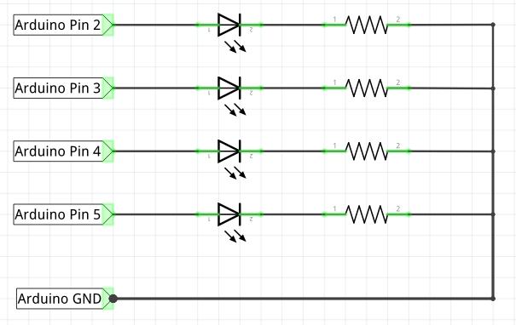
Circuit Diagram
Questions
Q: What resistor to use?
Q: What color LEDs?
Q: LED long leg go on the left or right?

Slide 21
Circuit Hint
220
Questions
Q: What resistor to use?
A: 220 Ohm
Q: What color LEDs?
A: your call!
Q: LED long leg on left or right?
A: Long leg on LEFT
red
green
220
blue
220
220
yellow
220
long
short

Slide 22
Hands On
Build the circuit, write the Sketch, get it working
If you have trouble with the sketch, a working version cylon.ino is available in the sketches folder
When you’re done, it’s lunch time!

Slide 23
Cylon “Pseudo Code”
Hands On
Setup should include these statements:
pinMode(2,OUTPUT);
pinMode(3,OUTPUT);
pinMode(4,OUTPUT);
pinMode(5,OUTPUT);
Loop code should do this:
Blink 2 on and off
Blink 3 on and off
Blink 4 on and off
Blink 5 on and off
Blink 4 on and off
Blink 3 on and off
Note: this is not the actual code!
Suggestion:
Write code to blink LED on pin 2
Use copy-and-paste to replicate blink code for pins 3, 4, and 5.

Slide 24
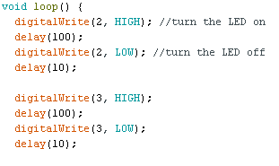
First Few Lines of Cylon
Hands On
Use Copy and Paste to fill out the remaining blinks. Then edit to use correct pin numbers.
Save As file: Cylon

Slide 25
Intro to Functions

Slide 26
What Are Functions?
Example: digitalWrite(3, HIGH);
digitalWrite is not part of C++ language
It is just a small built-in program that does all the small tasks required to set pin 3 to 5V
Nice because we don’t have to repeat all those commands each time we want to turn on an LED
It’s easy to write our own functions!

Slide 27
Intro to Functions
Let’s write a function called blinkit(x);
Purpose: to blink the LED connected to pin x ON then OFF.
Where x is integer variable
x is called an “argument”

Slide 28
The new Cylon program using blinkit
void loop(){
blinkit(2); //blink the LED on pin 2
blinkit(3); //blink the LED on pin 3
blinkit(4); //blink the LED on pin 4
blinkit(5); //blink the LED on pin 5
blinkit(4); //blink the LED on pin 4
blinkit(3); //blink the LED on pin 3
}
It’s much nicer, isn’t it?

Slide 29
The ‘blinkit’ function
void blinkit(int x){
// This function blinks the LED on pin x once
digitalWrite(x,HIGH);
delay(1000); //keep LED on for 1 sec
digitalWrite(x,LOW);
delay(500); //keep LED off for .5 sec
}
Working version is “cylonfunc.ino”

Slide 30
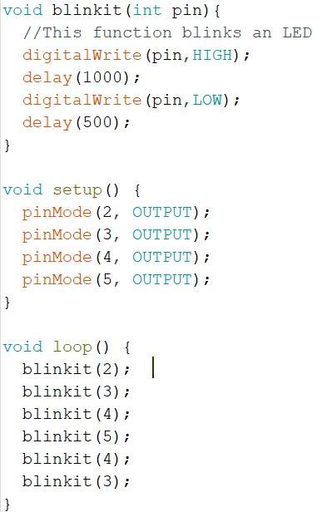
Here is the Complete Sketch
Hands On
Some Rules:
The blinkit function must be OUTSIDE of other functions (not within their curly brackets)
Functions should occur before setup and loop

Slide 31
Try Out Different Blink Patterns
Hands On
void loop(){
blinkit(2); //blink the LED on pin 2
blinkit(4); //blink the LED on pin 4
blinkit(3); //blink the LED on pin 3
blinkit(5); //blink the LED on pin 5
blinkit(5); //blink the LED on pin 5
blinkit(3); //blink the LED on pin 3
}
Now you can build a Christmas Tree Light System!!!

Slide 32
Challenges
Hands On
Extend your Cylon project with these features:
Modify circuit to have 8 LEDs
Modify code to have an “Interesting” blink pattern
Modify blinkit to allow variable LED delays
For example: blinkit(5, 100, 500); //LED pin 5, on 100, off 500
Skeleton code is provided to help you in the CylonFuncPlusSkel folder

